Slide 1
2019 Lake Auburn Buoy Data QAQC Summary
30Jan2020
B. Steele

Slide 2
2019 THERMISTORS

Slide 3
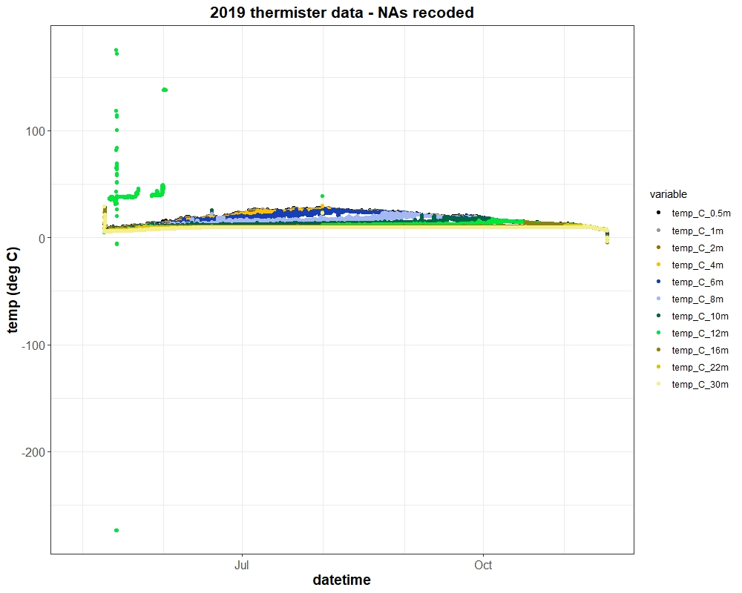
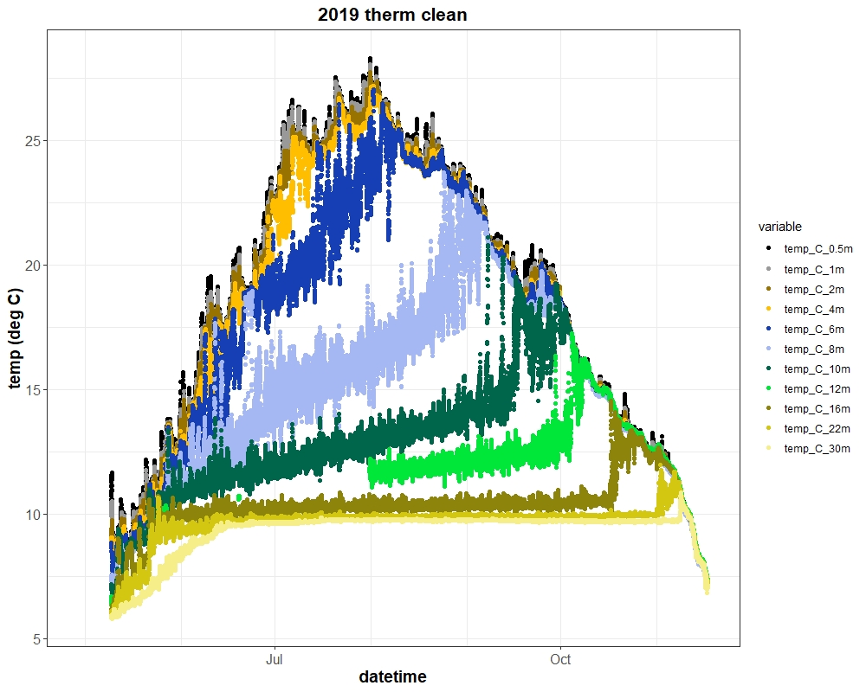
12m thermistor errant intermittently, recoded in part where incorrectly recording

Slide 4
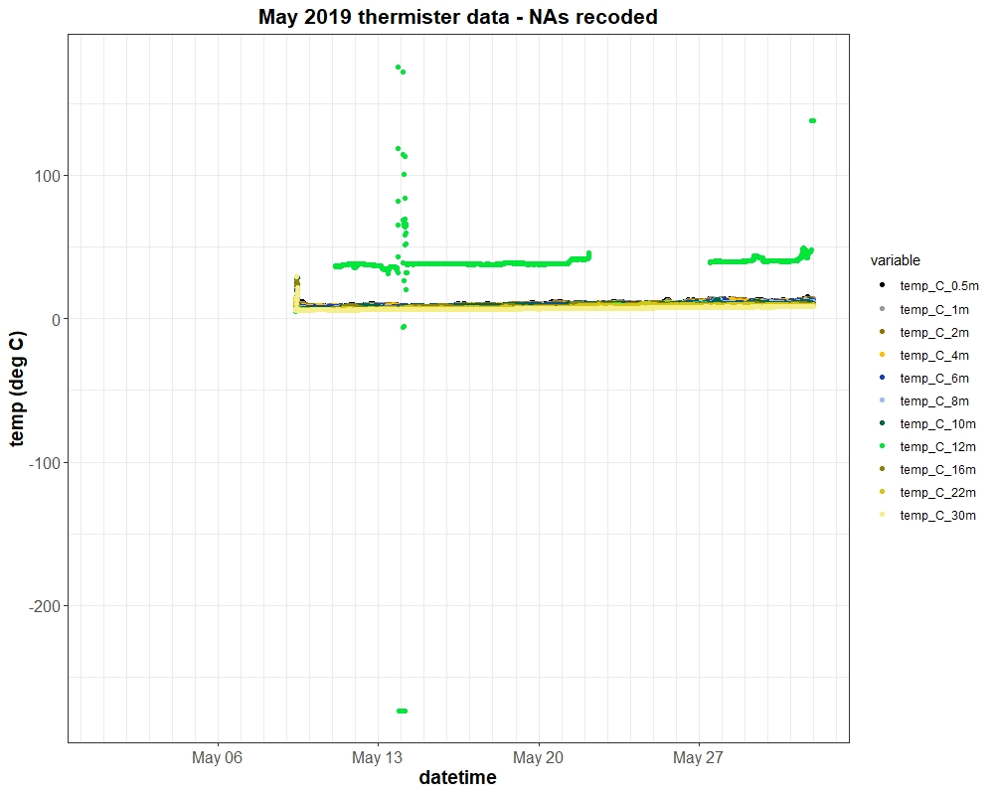
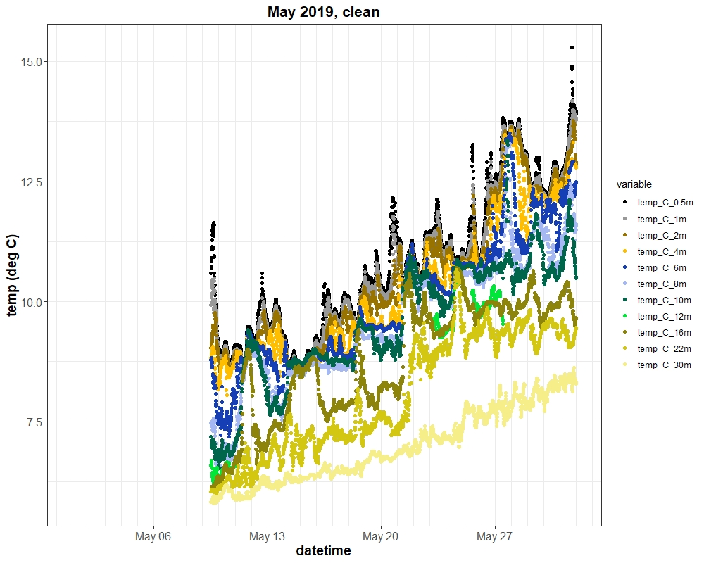

Slide 5
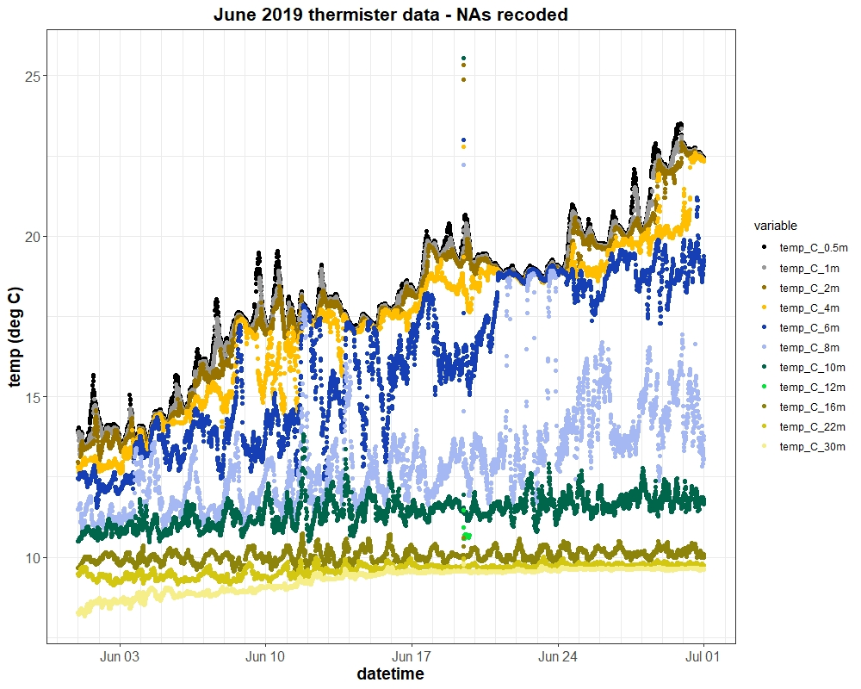
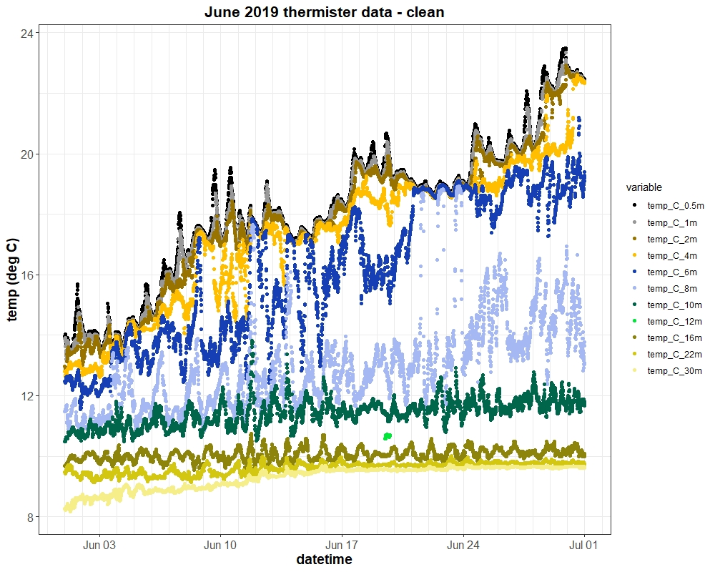
Not sure if we want to recode 12m thermistor to NA
until it is consistently reporting (end of July)

Slide 6
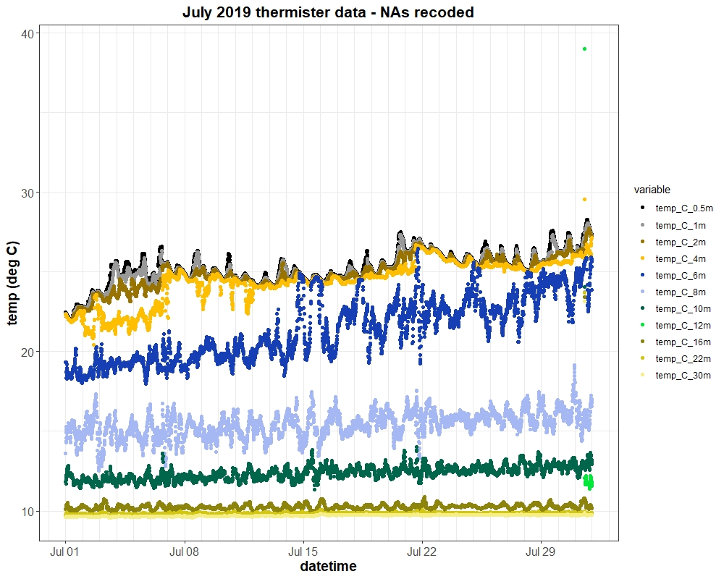
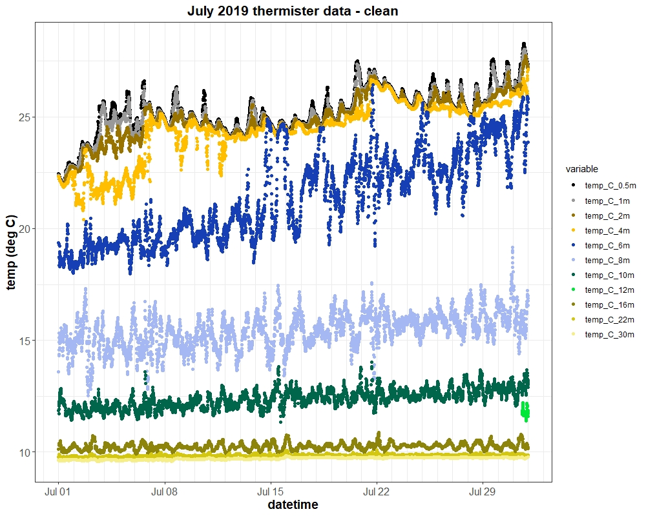

Slide 7
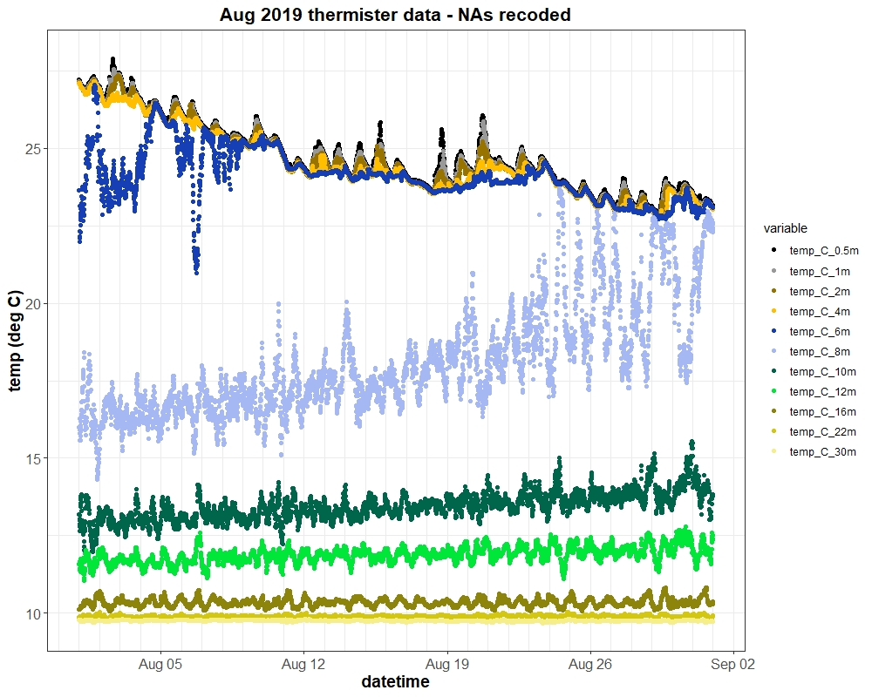

Slide 8
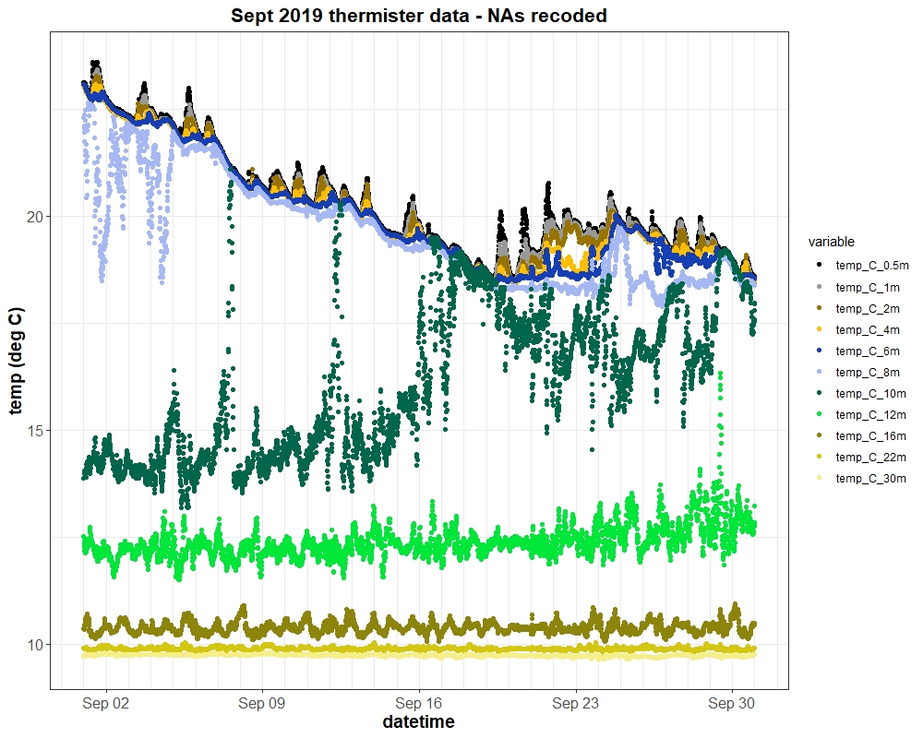

Slide 9
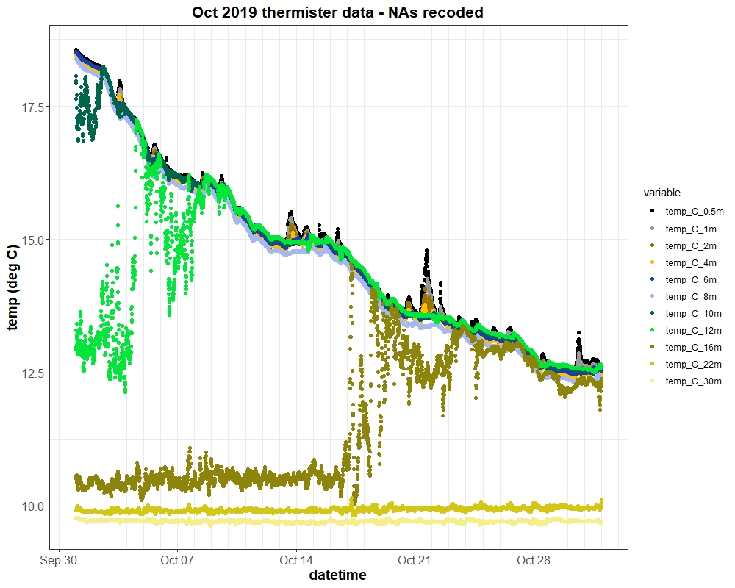

Slide 10
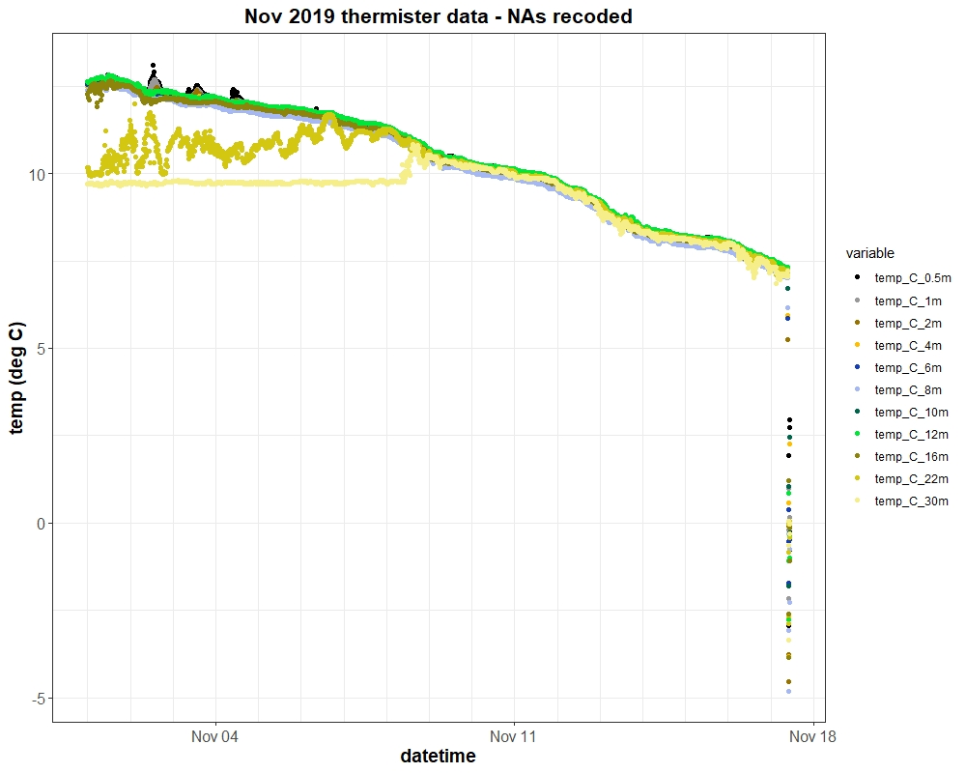
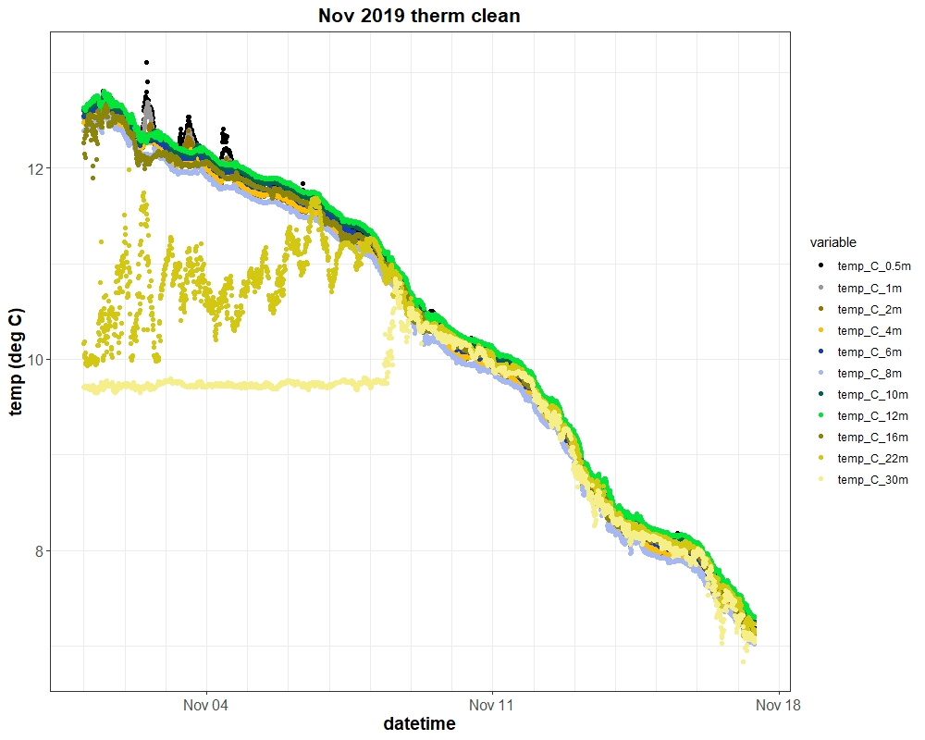

Slide 11
2019 DO PROBES

Slide 12
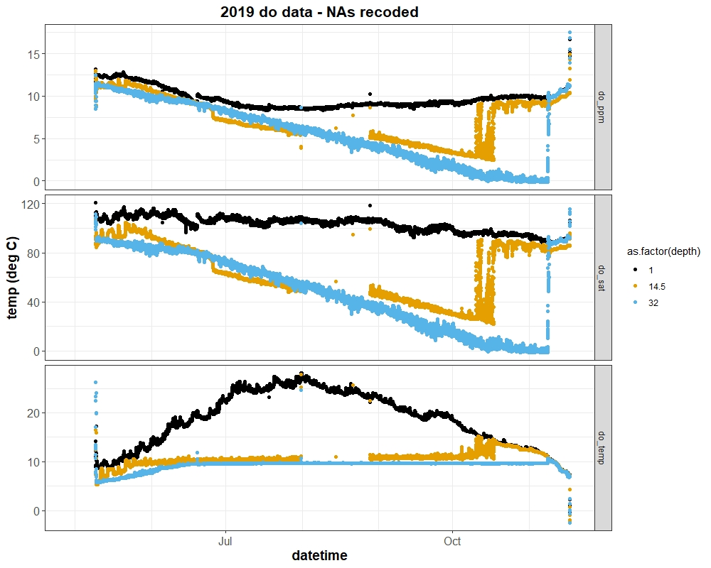
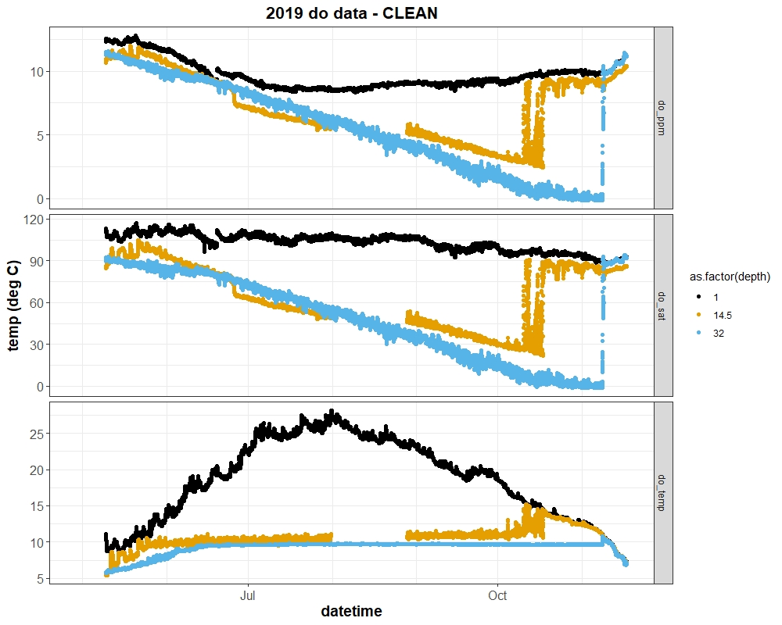
Not sure how much of the 14.5m probe should be recoded further than exhibited here. The temp is fine,
but the ppm and sat concentration look like they drift from day 1. We could flag until the precipitous drop
in late June and then recode there until replacement, but not sure how useful that would be to anyone.

Slide 13
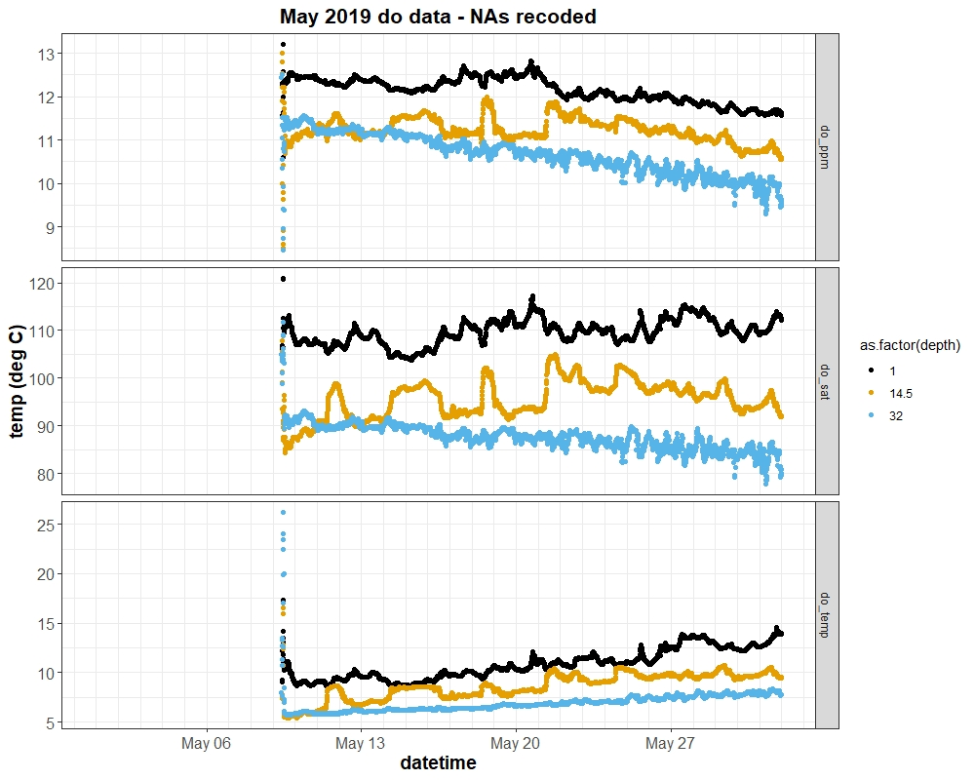
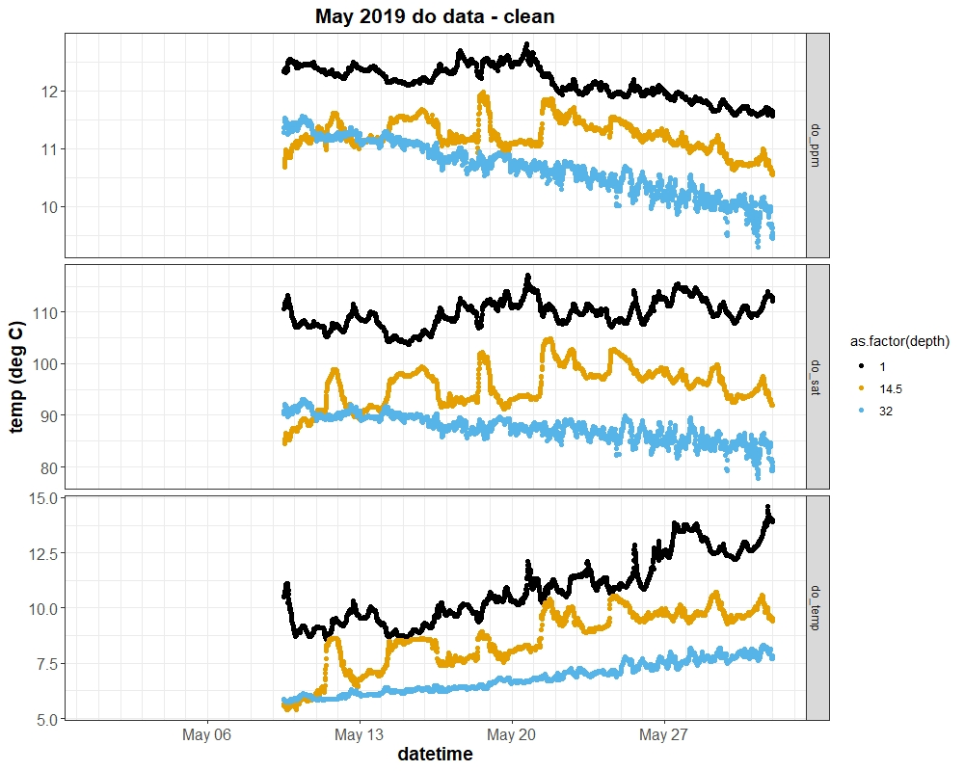

Slide 14
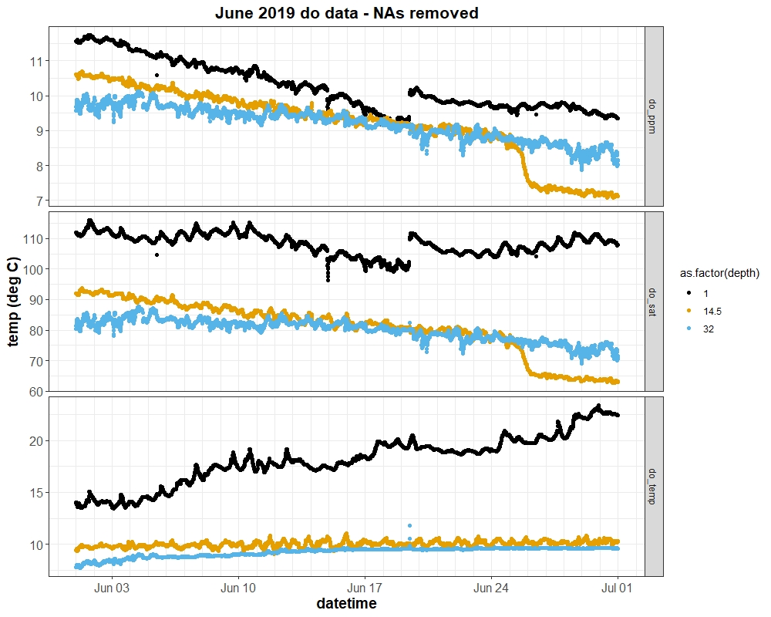
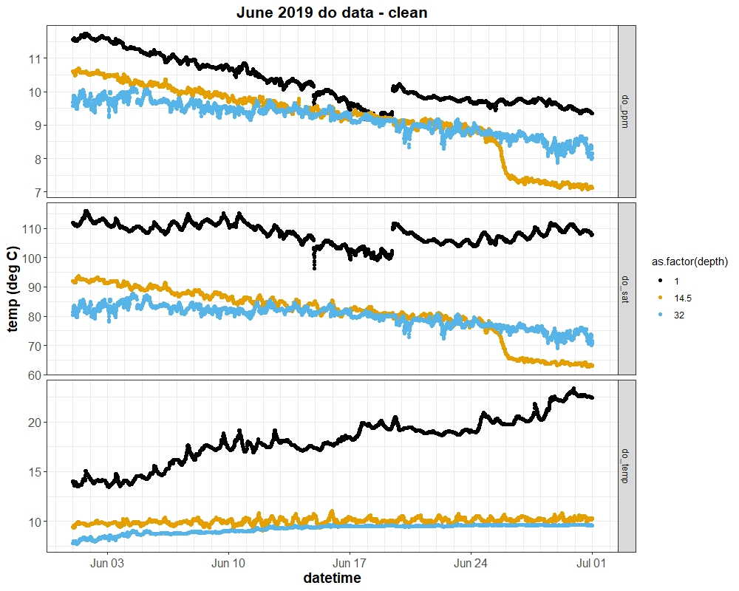
Note also the oddball readings in the 1m do probe – wonder if it’s on the fritz. Not sure how to deal with 14.5m
probe.

Slide 15
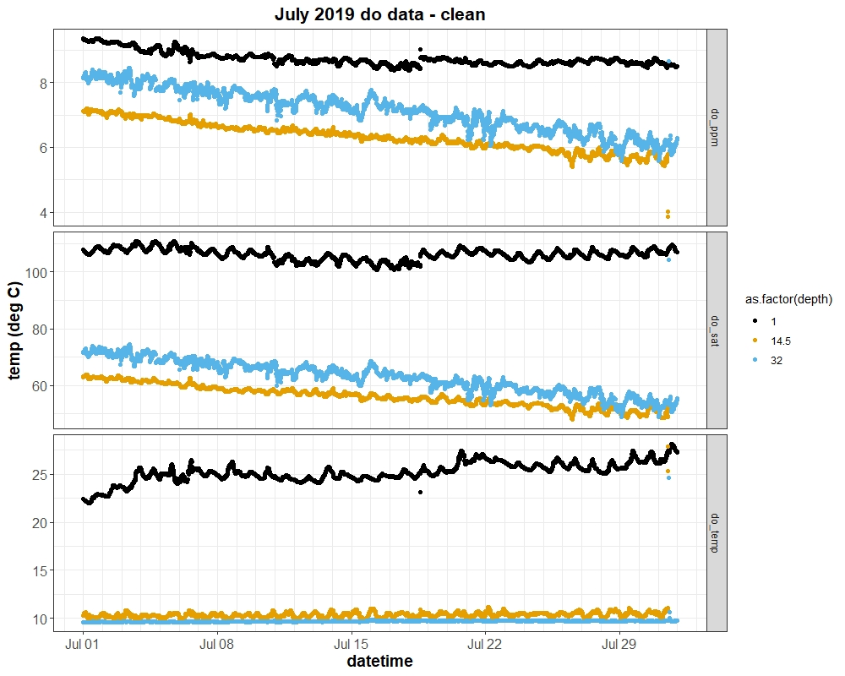
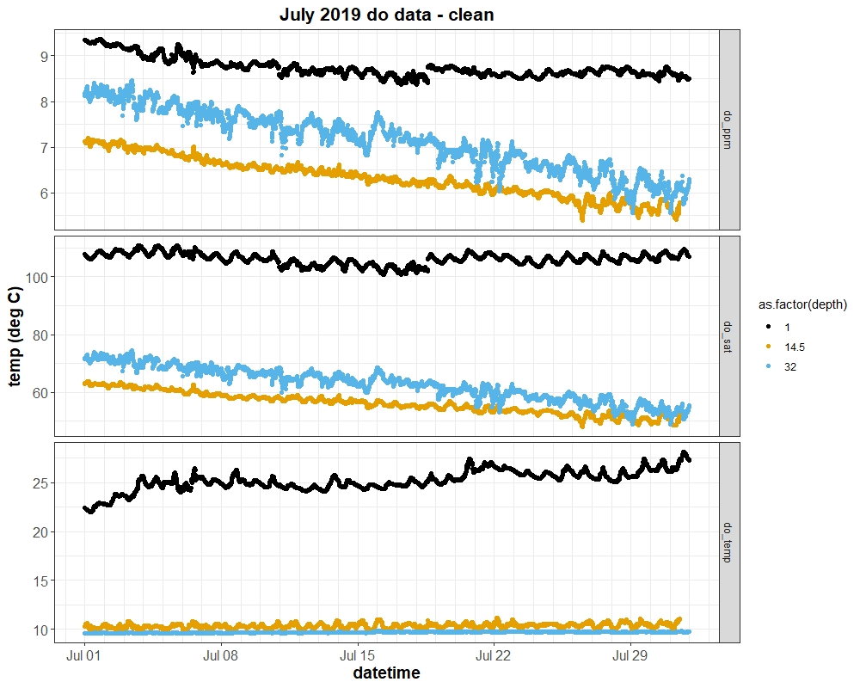

Slide 16
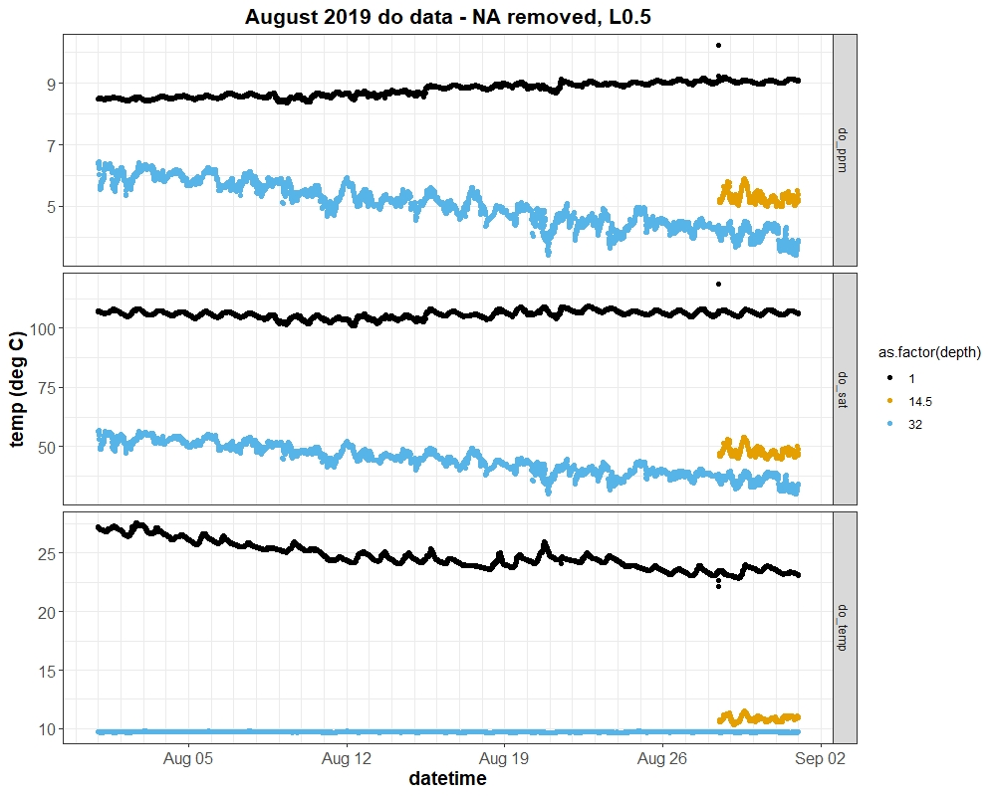
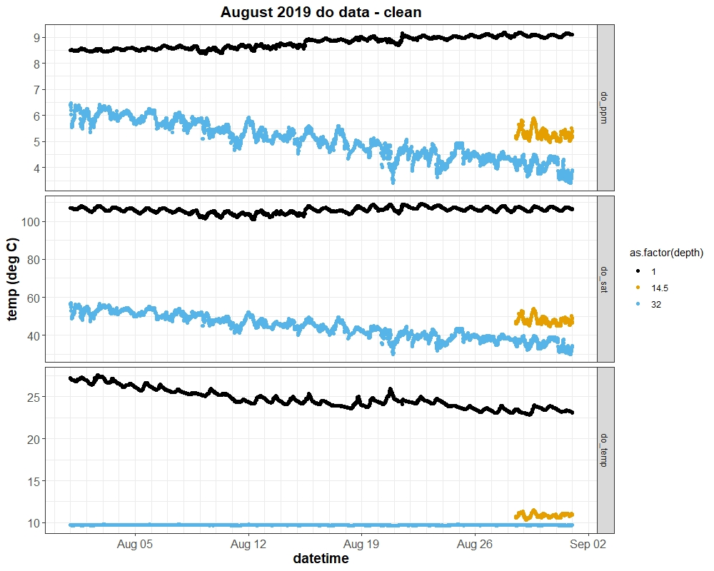

Slide 17
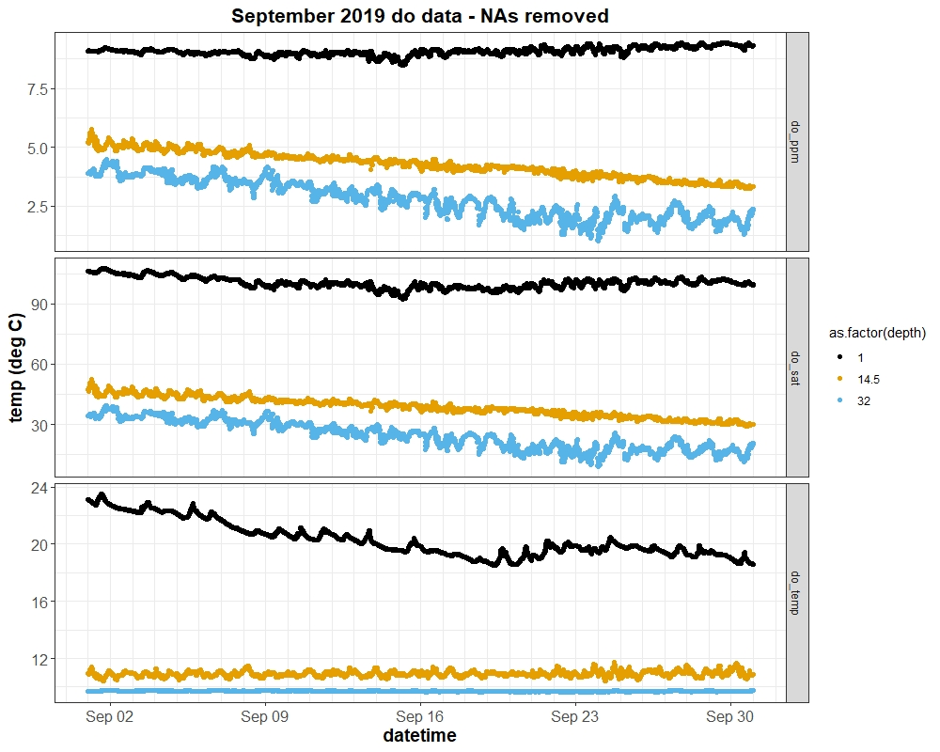

Slide 18
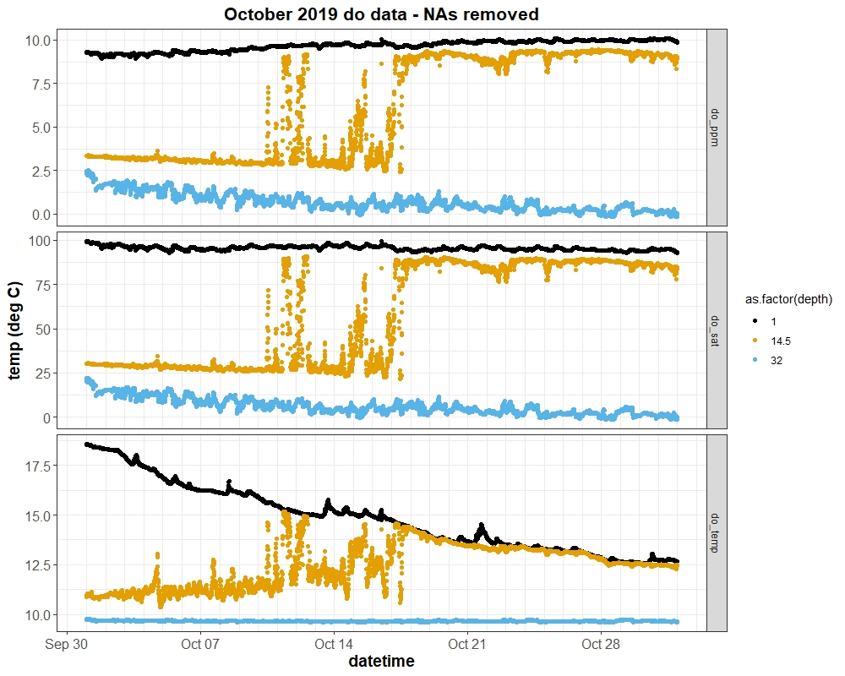

Slide 19
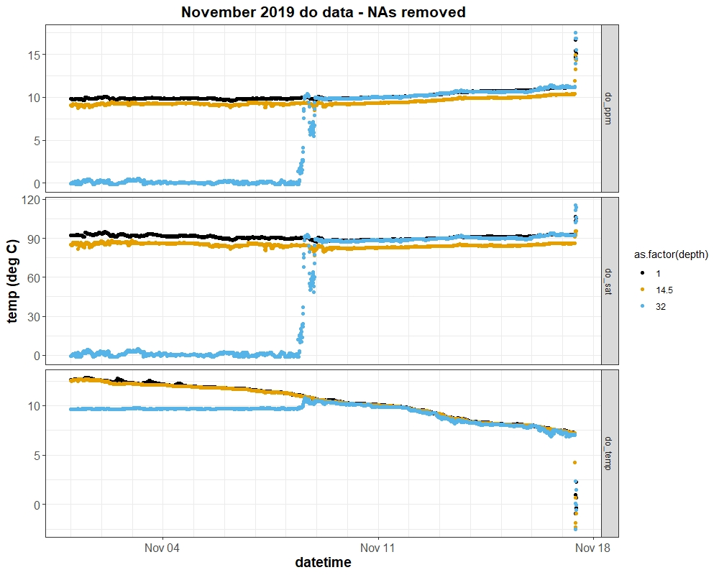
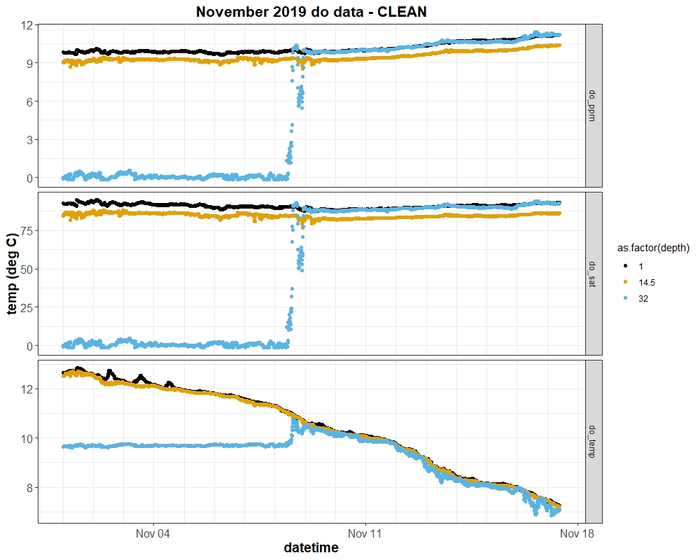
It seems obvious, but will have to make note of the 14.5 (or 1m & 32m) probes being calibrated slightly differently here.

